Slide 1
As engineering consultants and trusted advisors, Zutari co-creates an engineered impact that enables businesses to optimize their asset value chain.
Msunduzi
AM Policy workshop
2022 Client Engagement

Slide 2
RFP031/2021 Scope of work
Deliverable 6 : Develop AM Policy
Engage the municipality to develop an effective Asset Management Policy that will give clear direction and commitment to asset care / management in the context of the challenges of the municipality.
The purpose of the Asset Management Policy is to ensure infrastructure asset related decisions are aligned with community expectations and affordability, and service needs in a sustainable manner. It acts to moderate the risk of improperly managed assets. The engagement of top management in the process of the development of this document as well as a submission to Council is important.

Slide 3
Contents of Policy as per RFP031/2021
The Policy shall have the following minimum sections / chapters:
1. Introduction including context and purpose
2. Scope
3. Relationship to the IDP with the strategic context in terms of the Asset Management Framework which includes the Strategic Asset Management Plan and Asset Management Plans, and the legislative context.
4. Policy Statement by Council making asset care / management commitments.
5. Asset Management relationships, roles and responsibilities, including policy implementation.
6. How integration of asset management within the municipality will be achieved
7. Establish defined goals, service levels, inventory guidelines and standards of maintenance.

Slide 4
SANS 55001/CIDMS Requirements
Top management shall establish an asset management policy that:
is appropriate to the purpose of the organization;
provides a framework for setting asset management objectives;
includes a commitment to satisfy applicable requirements;
includes a commitment to continual improvement of the asset management system.
The asset management policy shall:
be consistent with the organizational plan;
be consistent with other relevant organizational policies;
be appropriate to the nature and scale of the organization’s assets and operations;
be available as documented information;
be communicated within the organization;
be available to stakeholders, as appropriate;
be implemented and be periodically reviewed and, if required, updated.

Slide 5
Leadership and commitment (SANS 55001)
Top management shall demonstrate leadership and commitment with respect to the asset management system by:
ensuring that the asset management policy, the SAMP and asset management objectives are established and are compatible with the organizational objectives;
ensuring the integration of the asset management system requirements into the organization’s business processes;
ensuring that the resources for the asset management system are available;
communicating the importance of effective asset management and of conforming to the asset management system requirements;
ensuring that the asset management system achieves its intended outcome(s);
directing and supporting persons to contribute to the effectiveness of the asset management system;
promoting cross-functional collaboration within the organization;
promoting continual improvement;
supporting other relevant management roles to demonstrate their leadership as it applies to their areas of responsibility;
ensuring that the approach used for managing risk in asset management is aligned with the organization’s approach for managing risk.

Slide 6
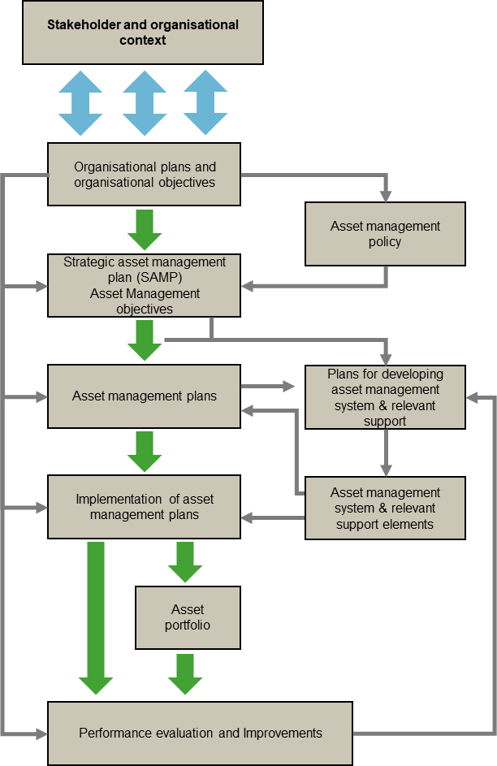

Slide 7
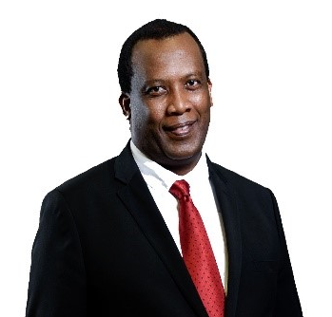
Simphiwe Hashe BSc (Hon ) Applied Science Pr.Tech.Eng.
Unit manager: asset management
E
M
Simphiwe.Hashe@zutari.com
+27 82 343 8470
Nomaphelo Ndzundzu BSc.Mech Pr.Eng. CMRP CAMA
Associate: Asset management
E
M
Nomaphelo.ndzundzu@zutari.com
+27 82 921 9773

Slide 8
As engineering consultants and trusted advisors, Zutari co-creates an engineered impact that enables businesses to optimize their asset value chain.
Msunduzi
Maturity Assessment
2022 Client Engagement

Slide 9
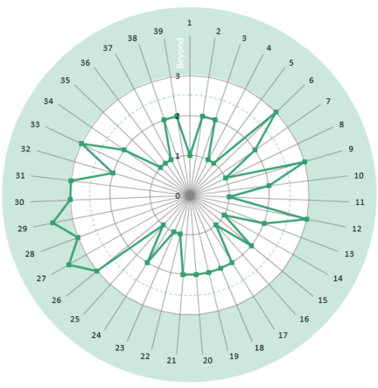
Our Holistic Asset Management Approach
Zutari uses a structured assessment methodology based upon SANS 55001 requirements and the Asset Management Landscape published by the Global Forum for Maintenance and Asset Management (GFMAM) for the asset management status quo assessments. The GFMAM landscape defines asset management as consisting of 39 subjects in 6 subject-groups, as shown in the accompanying Figure.
THE 39 ASSET MANAGEMENT SUBJECTS
BASELINE from which to DEVELOP improvement projects
Strategy & Planning | Organisation & People
Asset Management Policy | Procurement & Supply Chain Management
Asset Management Strategy & Objectives | Asset Management Leadership
Demand Analysis | Organizational Structure
Strategic Planning | Organizational Culture
Asset Management Planning | Competence Management
Asset Management Decision-Making | Risk & Review
Capital Investment Decision-Making | Risk Assessment and Management
Operations & Maintenance Decision-Making | Contingency Planning & Resilience Analysis
Lifecycle Value Realisation | Sustainable Development
Resourcing Strategy | Management of Change
Shutdowns & Outage Strategy | Assets Performance & Health Monitoring
Lifecycle Delivery | Asset Management System Monitoring
Technical Standards & Legislation | Management Review, Audit & Assurance
Asset Creation & Acquisition | Asset Costing & Valuation
Systems Engineering | Stakeholder Engagement
Configuration Management
Maintenance Delivery
Reliability Engineering
Asset Operations
Resource Management
Shutdown & Outage Management
Fault & Incident Response
Asset Decommissioning and Disposal
Asset Information
Asset Information Strategy
Asset Information Standards
Asset Information Systems
Data & Information Management
ASSET MATURITY SCALE
LEVEL 0
INNOCENT
LEVEL 1
AWARE
LEVEL 2
DEVELOPING
LEVEL 3
COMPETENT
LEVEL 4
OPTIMIZING
LEVEL 5
EXCELLENT
(GFMAM ASSET MANAGEMENT LANDSCAPE)

Slide 10
Maturity Assessment Results
Based on the findings from the Maturity Assessments, Improvement Projects that aim to close the “gaps” are identified and improve each of the subjects to a compenetrate standard
 | Asset Management Strategy and Planning
 | AM Decision-making
 | Lifecycle Delivery Activities
 | Asset Knowledge Enablers
 | Organisation & People Enablers
 | Risk, Review & Continual Improvement
Excellent
Optimizing
competent
Improvement Project 1
Improvement Project 2
Improvement Project 3
Improvement Project 4
Improvement Project 5
Improvement Project 6
Developing
Aware
Ignorant

Slide 11
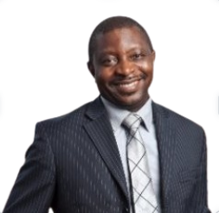
Simphiwe Hashe BSc (Hon ) Applied Science Pr.Tech.Eng.
Unit manager: asset management
E
M
Simphiwe.Hashe@zutari.com
+27 82 343 8470
Joe Paradza BEng. Mech, MSc Ind Eng, CAMA
TECHNICAL DIRECTOR: Asset management
E
M
Joe.Paradza@zutari.com
+27 78 444 9925

